Slide 1
Final Project Proposal
2026
Hannah Thacker

Slide 2
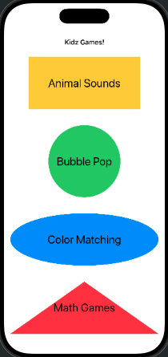
Introduction
My Project is an IOS App with simple games for children. The app will be set up in an arcade style, which means there will be several different games available to play inside the app. My app is called Kidz Games and as it says in the title this game is mainly for small children. The games within the app are easy learning games.

Slide 3
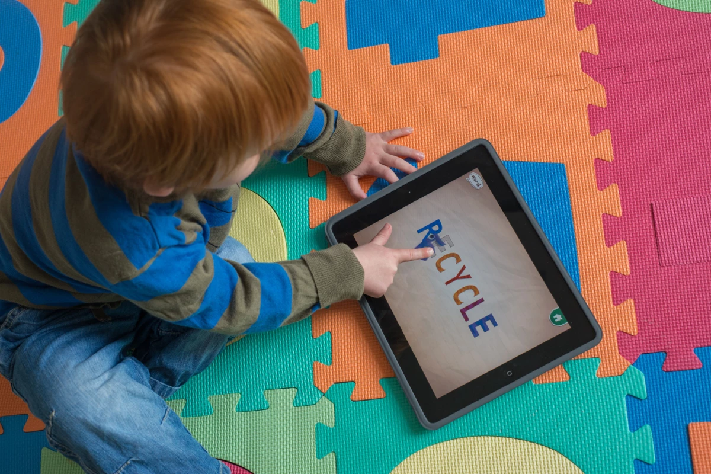
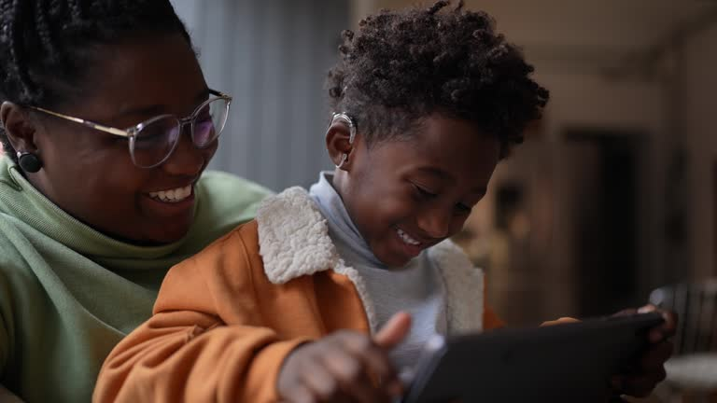
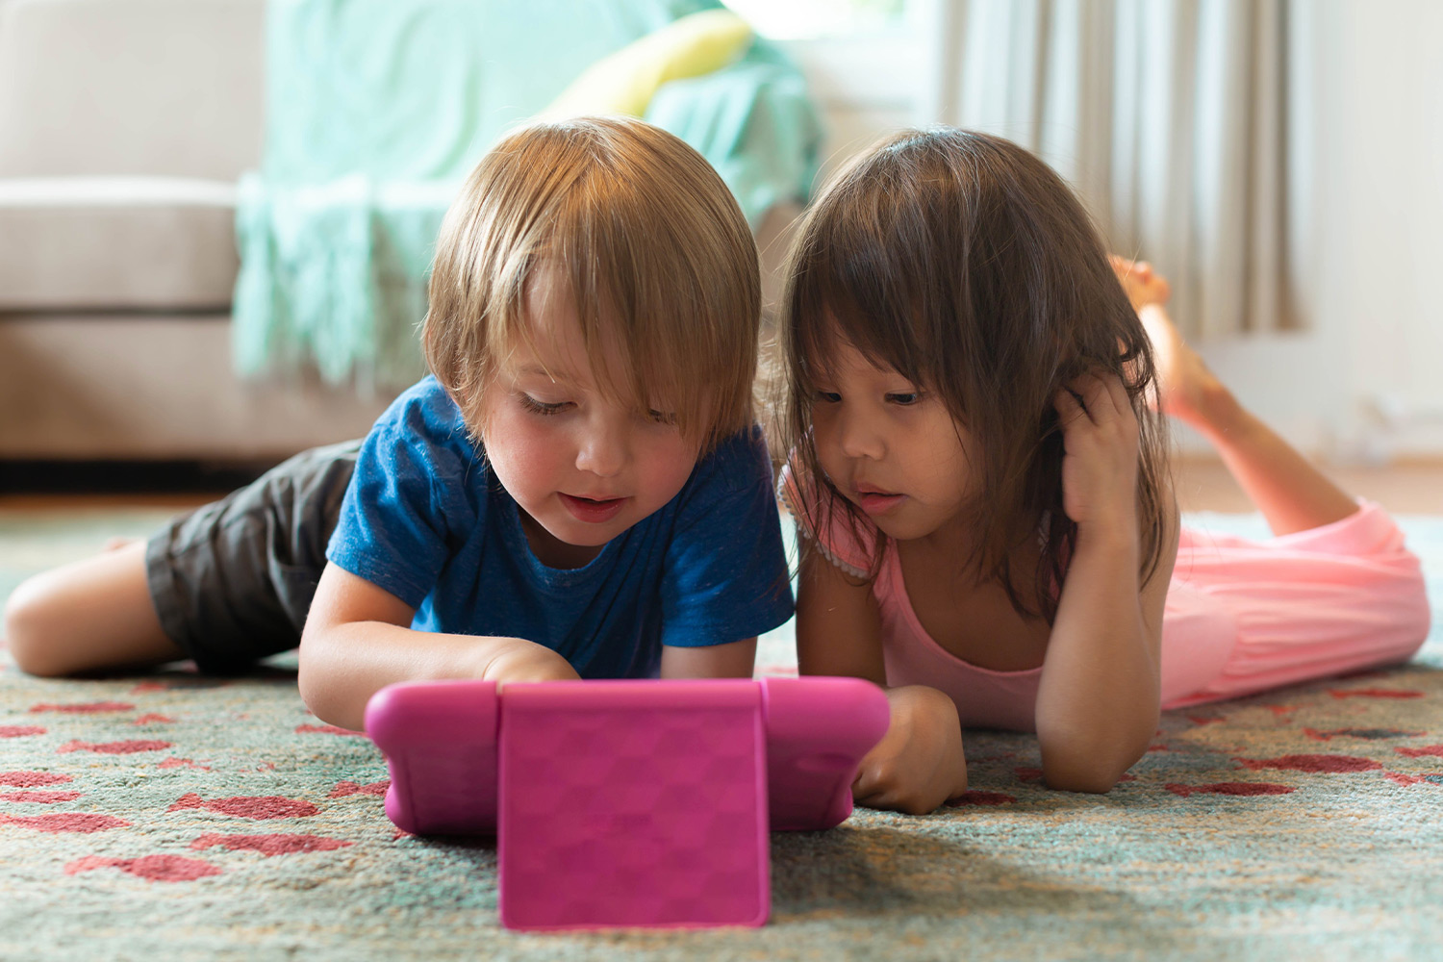
Target Population
As stated previously the target population of this app is Kids. It is literally in the name Kidz Games. To appeal to my target audience I used bright colors and fun shapes. Also using pictures instead of words for children who can’t read or are still learning. When marketing to children you also have to take into account the parents who monitor the media their children are consuming. The educational aspect appeals to parents and all included media is child friendly and appropriate.

Slide 4
Purpose to the Customer
This app will provide a fun way for kids to learn/practice simple concept such as animal recognition and mathematics. This is not a unique idea for an app there are countless others out there that are like this, both in terms of a learning app for kids and an arcade style game. However the combination of the two is fairly uncommon and what I am hoping to achieve here.
I wanted to challenge myself to make an app that was both fun and useful for its consumers. Using bright colors and fun shapes this app will keep kids entertained and keep their minds active. Kidz Games is fun and functional.

Slide 5

Constraints
Tracking data through the different views
I’ll make sure to bind my variables as needed
Adding Audio or video/animations
I am familiar with adding audio but I will need to do research if I need to add video or animations
Keeping track of the different Views and what variables carry over affecting functions
Organize all files into different folders and leave comments in code to easily find specific sections

Slide 6
Conclusion
My overall goal with this project is to create an app that is both functional and fun to use. This app will give me experience with basic IOS app development and design. It is a game designed for children to have fun while still keeping their brains active and learning. Making this App will showcase my skill and create an app that is useful while also being educational.

